Slide 1
Predicting Loan Default Risk
Team: Ian Housman, TJ Jaramillo, Darlene Ko, and Cy Shi

Slide 2
Agenda
01
Motivation and Considerations
02
Research and Data Set
03
Data Cleaning & Exploratory Analysis
04
Predictive Models
05
Best Fit Model and Conclusions

Slide 3
Overview of Data Set
32,581 Rows and 12 Columns (sourced from Kaggle.com)
Feature Name | Description
person_age | Age (in years)
person_income | Annual Income
person_home_ownership | Home Ownership
person_emp_length | Employee Length (in years)
loan_intent | Loan Intent / Type
loan_grade | Loan Grade
loan_amnt | Loan Amount
loan_int_rate | Loan Interest Rate
loan_status | Loan Status (0 is non default; 1 is default)
loan_percent_income | Loan Percent Income / Loan-to-Income Ratio
cb_person_default_on_file | Historical Default
cb_person_cred_hist_length | Credit History Length (in years)

Slide 4
Data Cleaning &
Pre-processing
Removed Null Values
Defined Target & Features
● 32,581 to 28,632 Rows
● Target = Loan Status
● Features = 11 Remaining Columns
Removed Outliers
Split Data into Training vs. Testing
● Age
● Years of Employment
● Training @ 75% = 21,474 rows
● Testing @ 25% = 7,158 rows
Converted Categorical to Numerical Values
Scaled or Normalized our data and used StandardScaler
● Home Ownership
● Loan Type
● Loan Grade
● Default History

Slide 5
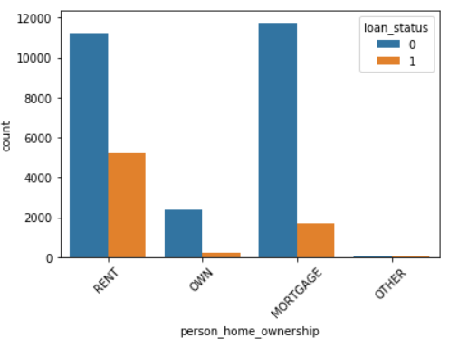
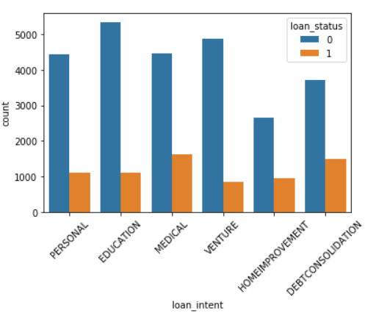
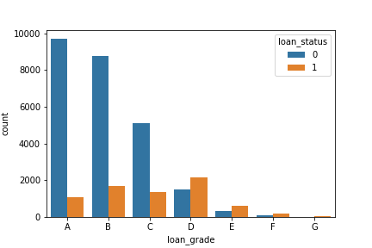
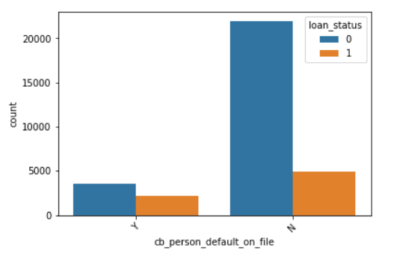
Exploratory Analysis
Categorical Features
Home Ownership
Loan Type
Loan Grade
Default History
* Converted to Numerical Values to train
Machine Learning Model
Non-Default
Default

Slide 6
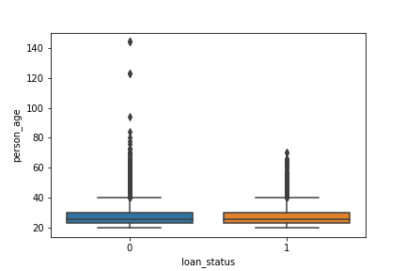
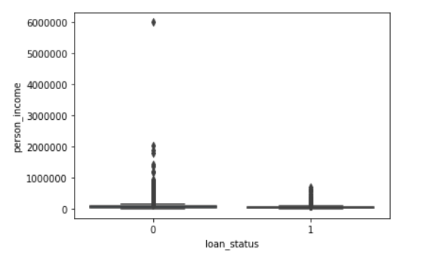
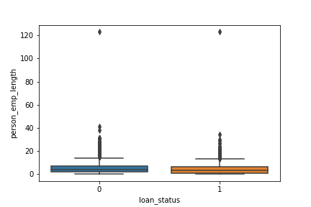
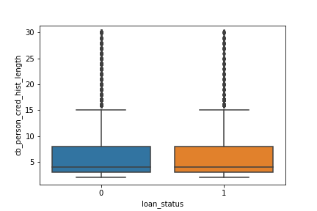
Exploratory Analysis
Numerical Features (Borrower Info)
Age
Income
Non-Default
Default
Employment Length
Credit History Length

Slide 7
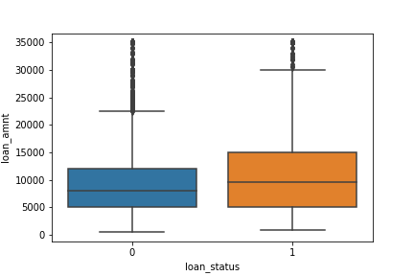
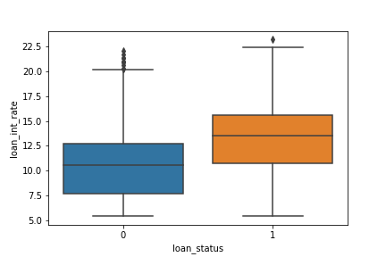
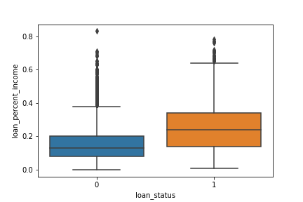
Exploratory Analysis
Numerical Features (Loan Info)
Loan Amount
Loan Interest Rate
Loan-to-Income Ratio
Non-Default
Default

Slide 8
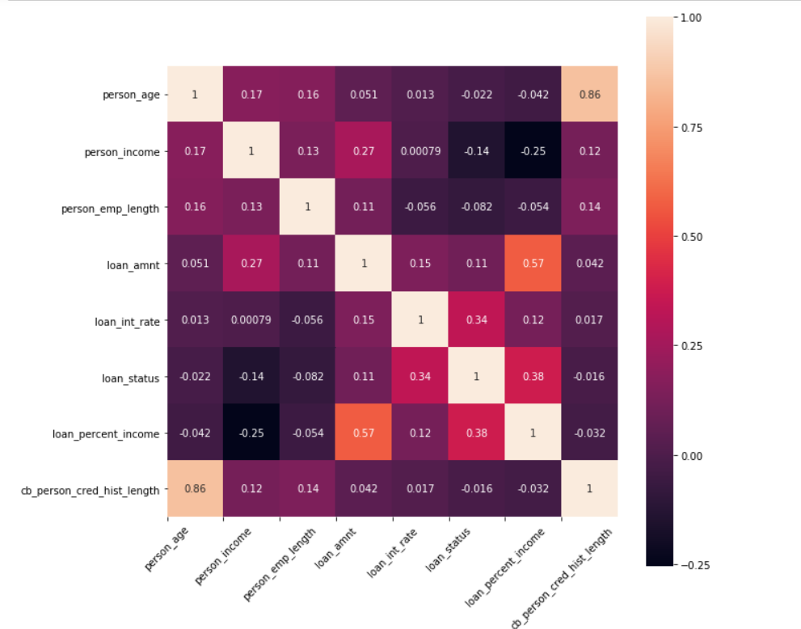
Exploratory Analysis
Correlation Matrix

Slide 9
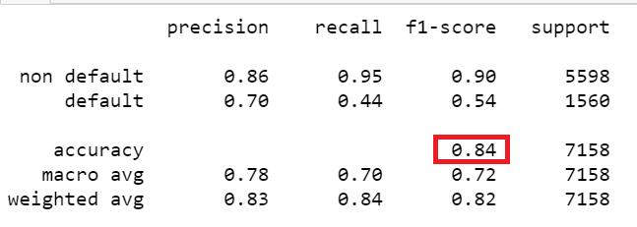
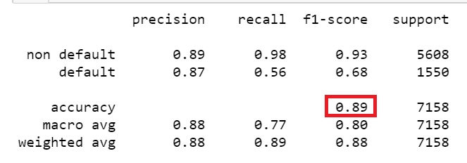
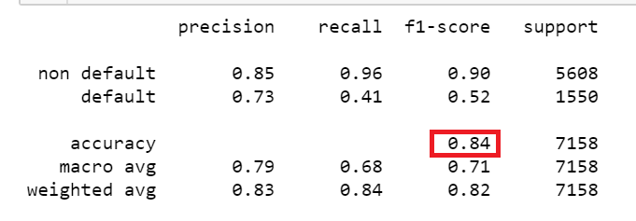
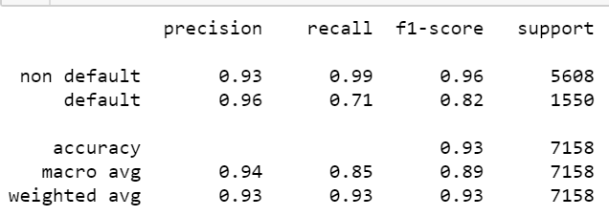
Comparison of Predictive Models
The best fit model is Random Forest with an accuracy score of 0.93.
Logistic Regression (Baseline)
KNN
SVM
Random Forest

Slide 10
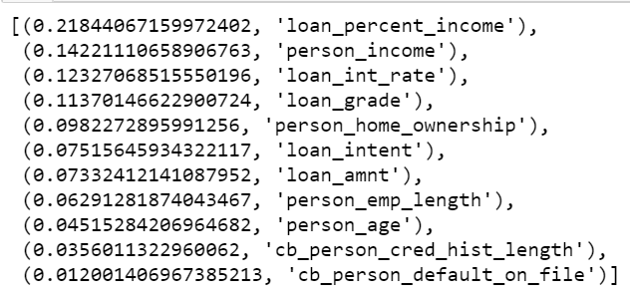
Best Predictive Model (Random Forest)
Ranked Feature Importance and Other Metrics
Highest Accuracy Score
● Hypertuned Parameters (e.g. Grid Search)
● Training Data = 0.9552
● Testing Data = 0.9310
Robust Model
● Bagged Decision Trees (reduces variance)
● Splits on Random Subset of Features
● Ranked Feature Importance (shown left)
Additional Advantages
● Great with High Dimensionality
● Quick Prediction / Training Speed
● Robust to Outliers and Non-linear Data
● Handles Unbalanced Data
● Low Bias, Moderate Variability
In summary, Random Forest is the best predictive machine learning model based on the above. Our machine learning model is fully deployed through Amazon Web Services (Elastic Beanstalk). Please click on the following link:
http://loandefaultrisk-env-2.eba-k2mgprmy.us-east-2.elasticbeanstalk.com/

Slide 11




Our Team
Rice University Data Analytics and Visualization Certification Program
Ian Housman
TJ Jaramillo
Darlene Ko
Cy Shi

